Slide 1




GET SET GIT
3.0
Google Developer Groups
On Campus
UPES Dehradun
⚪

Slide 2

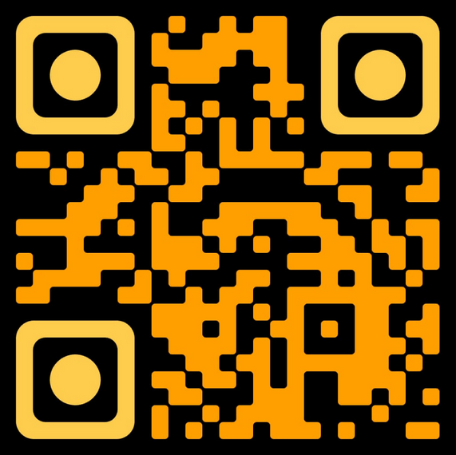
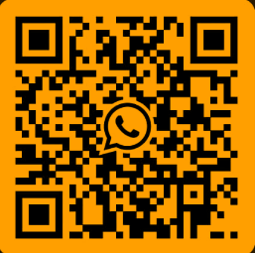

WELCOME!
Please Scan the QRs above to access the resources shared post event

Slide 3


Our Speakers
Aantriksh Sood
Amulya Jain

Slide 4


Campus Organiser
Archisha Dhyani

Slide 5


Why Do We Need Git?
> Because even code needs a social life. With GitHub, your code's out there mingling, making friends, and maybe even finding its perfect merge— while you’re on the couch scrolling memes.
> To keep track of your code’s wild adventures. Git remembers every feature you ever added (and every bug you wish you hadn’t). So you can finally answer, “What did your code do last summer?”

Slide 6
Why Do We Need Git?
> Because it’s like a time machine for developers. Accidentally break your code? Git can rewind to a time when everything was functional, saving you from a coding catastrophe.
> Because where else can you say “Fork you!” and mean it in a good way? On GitHub, forking isn’t just allowed; it’s encouraged, helping your code spark fresh ideas and new collaborations.

Slide 7
What are we Learning Today?
> Difference & Explanation of Git & Github
> Hands-On Git
> Intro & Practice of Git Bash and Basic Commands
> Brief About Open Source & its Programs

Slide 8



GITHUB VS GIT
Goals
GitHub
Git
GitHub is a web-based platform that hosts Git repositories and provides collaboration features.
Enables sharing, collaboration, and social coding in the cloud.
Git is a version control system for tracking changes in source code during software development.
Manages version control locally on a developer’s machine.

Slide 9

> Benefits of Git & Github
> COLLABORATION
> VERSION CONTROL
> CONFLICT AND MERGE
> BACKUP SYSTEM
> DISTRIBUTION
GIT AND GITHUB?

Slide 10
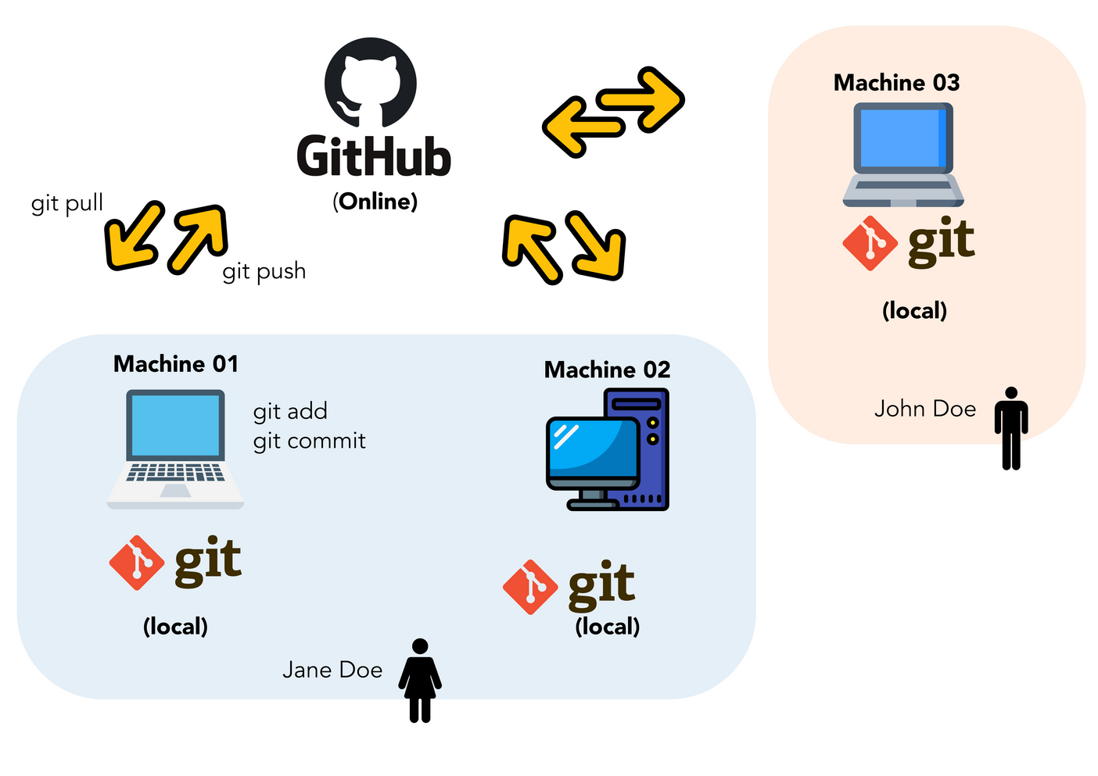
COLLABORATION

Slide 11
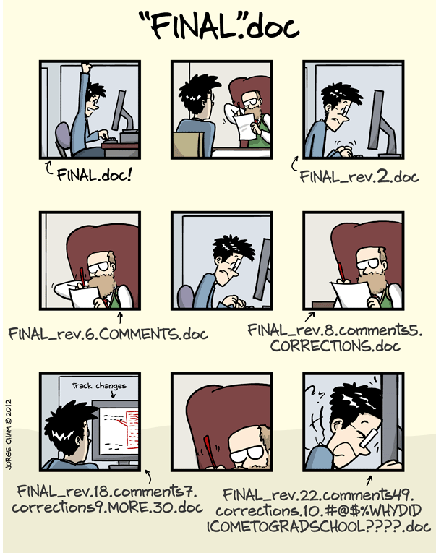
VERSION CONTROL

Slide 12
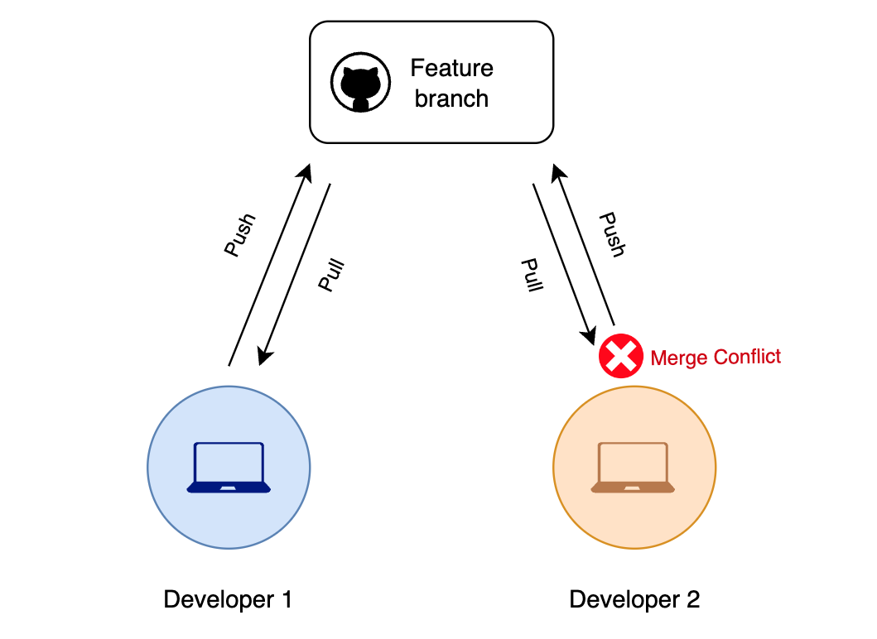
CONFLICT & MERGE

Slide 13



Creating a GITHUB account
We’ll be screensharing our screen
KINDLY KEEP FOLLOWING

Slide 14

GIT INSTALLATION
https://git-scm.com/downloads

Slide 15
Important Bash Commands
pwd
print working directory
cd
change directory
mkdir
Make Directory
cd ..
Navigate Up
ls
List
01
02
03
04
05
Shows the full path of the current directory you're in.
For example,
typing pwd,
outputs
~/Username/File
Use cd to navigate your file system.
For example, move to a specific directory with
cd my-project-directory
List files and directories in the current directory using ls.
For example,
type ls
it will list files and folders
Create a new directory with mkdir new-folder
Move up one directory level using cd
For example,
~/Users/Username and type cd ..
it will move you up to ~/Users

Slide 16



INTRODUCING GIT BASH
Let's explore Git Bash now, a command-line interface that allows direct interaction with Git repositories on your computer.
Set Username
git config --global user.name "Your Name"
Set Email
git config --global user.email “youremail@example.com”

Slide 17
GITHUB TERMINOLOGY
Goals
REPOSITORY
A repository is a digital folder where you keep all the stuff related to your project, like files, documents, and code. It helps you keep everything organized and track changes.

Slide 18
GITHUB TERMINOLOGY
USER REPOSITORY
You can name your repository anything but when you name a GitHub repository with your username, it creates a special repository known as your "user repository." This repository serves as a way to host files and content that you want to associate with your GitHub profilel

Slide 19
GITHUB TERMINOLOGY
FORKING
Forking a repository means creating a copy of someone else's repository under your GitHub account. This allows you to make changes without affecting the original repository

Slide 20
CLONING
Cloning a REPOSITORY
Cloning means creating a local copy of a remote repository (remote means the repository that is on your GitHub profile online), similar to checking out a library book
> git clone <repo_url> | To clone a remote reporistory to your local one

Slide 21
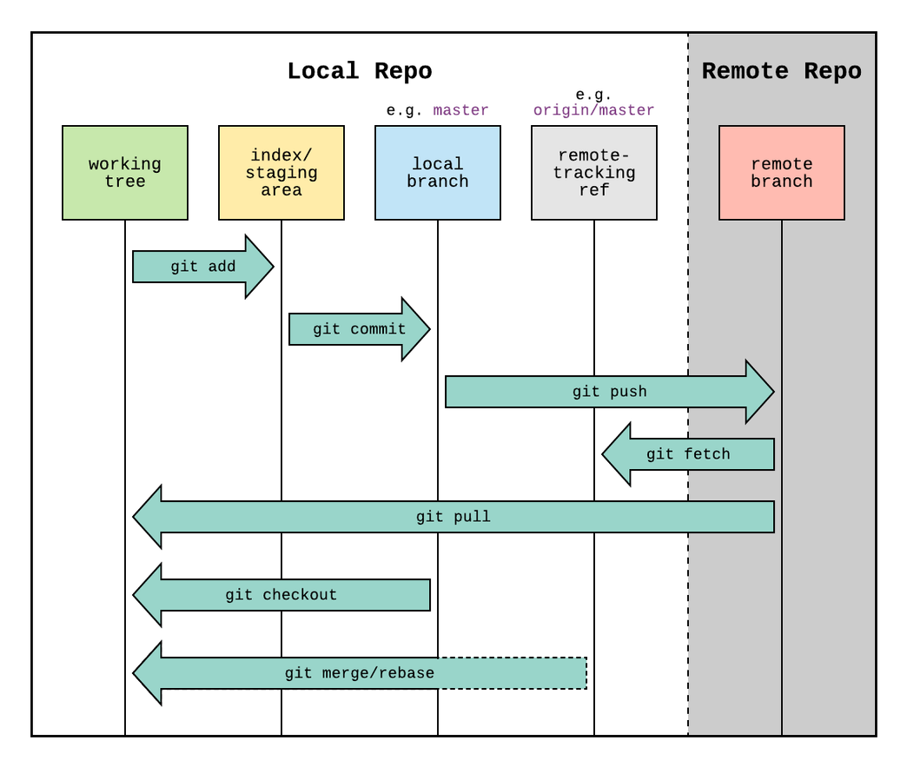
GIT WORKFLOW

Slide 22
Essential Git Commands
> git add <filename(s)>: Stages changes for commit.
All Changes: -A (all files), . (current directory).
Modified & Deleted Only: -u
> git commit: Records staged changes in the repository.
Message: -m "<message>" adds a commit message inline.
All Tracked Changes: -a skips git add, committing modified/deleted files.
> git push : Uploads local commits to a remote repository.
Specify Remote & Branch: git push <remote> <branch>
Force: -f or --force overwrites remote history.

Slide 23
Essential Git Commands
> git fetch <branch-name>: Retrieves updates from a remote repository without merging them into your local branch.
> git pull : Fetches updates from a remote repository and merges them into the current branch.
> git checkout <branch-name> : Switches branches or restores files in the working directory.
Create & Switch: -b <new-branch> creates and switches to a new branch.
File Restore: git checkout <branch> -- <file> restores a file from a specific branch to the working directory.

Slide 24
OPEN SOURCE
1. Pick a Project & Fork it
2. Clone it & Add your touch
Open Source is Software with publicly accessible source code, allowing anyone to view, modify, and distribute it. Promotes collaboration, transparency, and community-driven development.
Find an open source project that interests you. There are tons out there for every skill level.
Clone the project to your computer using Git. It's now your playground.
Make improvements, fix bugs, or add new features. It's your chance to shine!
HOW TO GET INVOLVED IN OPEN SOURCE?
3. Share Your Work:
4. Raise Your Hand
Push your changes back to your forked project on GitHub.
Create a pull request to propose your changes to the original project. It's like saying, "Hey, check out what I did!"

Slide 25
Google Summer Of Code
GSoC
GSSoC
Hacktober Fest
Celebrate open source every October.
international annual program held in summers.
Earn while contributing during the summer.
SOME COOL OPEN SOURCE PROGRAMS
LFX Mentorship
Mozilla Open Source Support (MOSS)
Apache Software Foundation
Open source mentorship program held by Linux Foundation
Funding for projects that make the internet better
Home to many open source projects

Slide 26
WITH THIS WE CONCLUDE
GET SET GIT
3.0
Google Developer Groups
On Campus
UPES Dehradun
⚪

